Slide 1
World History CHAPTER 5
ROME AND THE RISE OF CHRISTIANITY

Slide 2
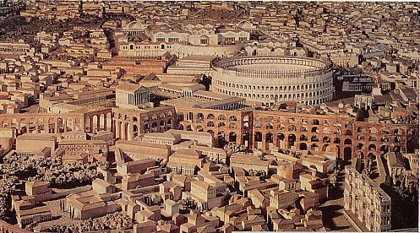
Get out a piece of paper, title it
5.1 Rise of Rome
Write the Big Idea and then work on Vocab packet.
Big Idea: The Romans Conquered and controlled the Italian peninsula and entire Mediterranean world.
Notes:
First we are going to look at the geography of Rome and compare it to other civilizations we have talked about.
What are things you want in the geography of an empire for it to prosper?
Fertile land
Natural barriers –protect

Slide 3
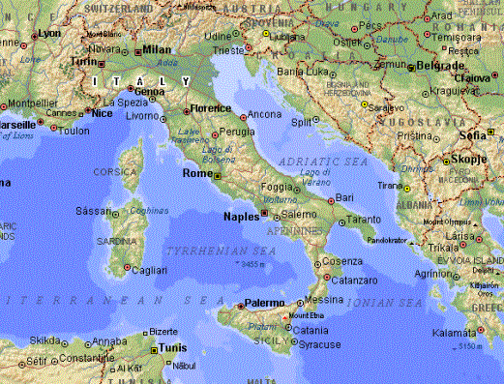
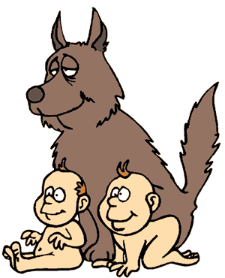
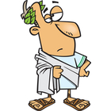
Geography of Rome 1500 B.C
Apennine Mts. Divided Italian Peninsula -east &west.
Po River, plain of Latium (Rome –central on 7 hills =defendable) > land to farm=large pop
Italian pen.>center of med sea=control sea trade
1st ppl- Latin's (herders/farmers)>spoke Latin
800 B.C. Greeks ( culture=alphabet)
Etruscans biggest influence >Rome=city & adopt Etruscan toga
What role did geography play in Rome’s defense and prosperity?
Notes:
Apennine Mt not rugged like Greece-didn’t divide country
More land to farm=large pop
Built on 7 hills inland on the Tiber river- protected from pirate raids
Romulus and ramous
Great uncle sent down Tiber river
Female found and raised
Discovered Rome
1st ppl were indo Europeans from the north who spoke Latin an indo European language.

Slide 4
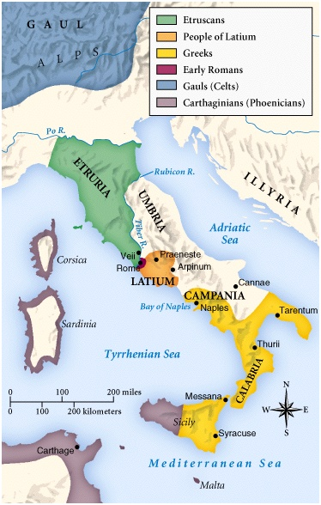
Roman Republic
Italy in 750 BCE
509 B.C. Etruscans overthrown= Republic =start of Roman empire.
War &Conquest
Next 200 yrs battle = control of Italian pen.= empire.
Create Roman Confederation.
some ppl Roman citizens (Latins).
Conquered ppls feel they have stake in Rome’s success.
Notes:
Once Etruscans overthrown create Republic=leader is voted in and some citizens have the right to vote
Romans fight for 200 years to gain control over all of Peninsula – map is before Romans start to overtake .
When they overtake they do allow Latin's to have citizenship and make it clear that if others are true allies with sending troops the could run their own affairs and become allies.
This made the people who were conquered feel as though they had a stake in the success of rome.

Slide 5
Successful strategies
Early Ancestors successful >virtues-sense of duty, courage & discipline (written by Livy (Roman Historian )
Other characteristics =successful:
Good diplomats
Excelled in military matters>built colonies & connecting roads =move troops.
Law & politics –practical=Created political institutions to solve problems.
Political Structure- groups of order:
Patricians = wealthy landowners, ruling class , vote, elected to office
Plebeians = small farmers, artisans, vote
Notes:
Diplomat-person who can deal with people in a sensitive and effective way
They work with the people the took over and didn’t try to take absolute control over them.
They were persistent soldiers and when their troops were beat they regrouped and made themselves stronger.
They made roads that connected their cities which made it easier for them to move between towns – troops . Same reason why our highways were created FDR WWII
Rome was divided into two social groups
Patricians and Plebeians
patricians-wealthy land owners who became ruling class
Plebeians- were the less wealthy landowners, artisans, and merchants. They were larger than the patricians.
Only patricians could be elected to office
Both could vote

Slide 6
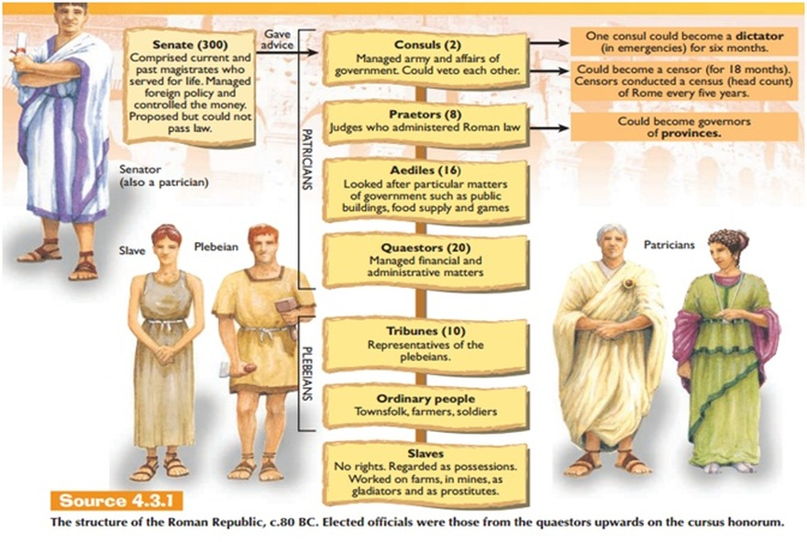
Political Structure Cont.
2 chief executive offices –
Consuls, 2 chosen every year, ran gov. & led the army into battle.
Praetors – in charge of civil laws, laws that applied to Roman citizens.
Roman Senate – 300 Patricians, serve for life. Had force of law.
Eventually Plebeians got own council called the Tribune. Pg. 149
Notes:
2 executive offices
Consuls –every 2yrs/ ran gov and led army into battle
Praetors( Pree*tuhrz)- in charge of civil law which are the laws that apply to the citizens. They also took on other offices like judging cases of none citizens.
The roman senate
300 patricians
Served for life
At first it was used as a way to advise officers, by the 3rd century they would have the force of law.
The roman republic had more assemblies than just the senate
Centuriate- elected chief officials( consuls and praetors) and pass laws
It was organized by the wealthiest so they had the majority.

Slide 7
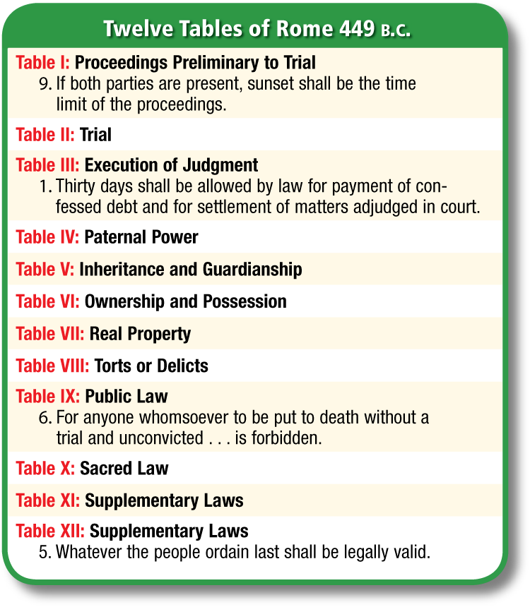
Struggle of the Orders (classes)
Plebeians wanted political & social equality bc they served(army).
The Tribune (council of plebeians) eventually got the right to pass law for all Romans.
Roman law-System of law was greatest gift.
Twelve Tables was first – was inadequate for later Roman needs.
Civil Law applies to Roman citizens only.
Law of Nations –Applied to all & based on natural law (ex: innocent until proven guilty, allow lawyer.)
Explain how the Plebeians and Patricians were different?
Notes:
Eventually the tribune is created
The tribune came from a group called the Plebs and were selected from the Plebs to protect the interest of Plebeians.
Eventually Plebeians are also allowed to marry the Patricians and to become consuls. Plebs eventually will also be able to receive the right to pass laws for the all Romans.
It took 200 yrs about for the Plebs to gain more power, but still most of the power resided in the hands of the wealthy Patricians and Plebeians.
Besides government structure the other great gift to the world from Rome was their gift of law
12 tables of Roman law was first but did not really work very well. It was the first publicized law code that required the Patricians and Plebeians to follow the same laws. Before this the patricians had made all the laws which gave them an advantage over the plebeians.
Next was a system of civil law which applied to only roman citizens and left questions of what to do with people that were not natural roman citizens. What laws? Do they follow?
They finally decided to create the Law of Nations which was based on natural law or what we are born with. for example you are innocent until proven guilty.
Show video (6min) structure of Roman Government
Answer the question bubble: Answer- patricians – wealthy landowners and controlled government offices and privileges. Plebeians – majority of people and could not hold offce in the senate or marry patricians.

Slide 8
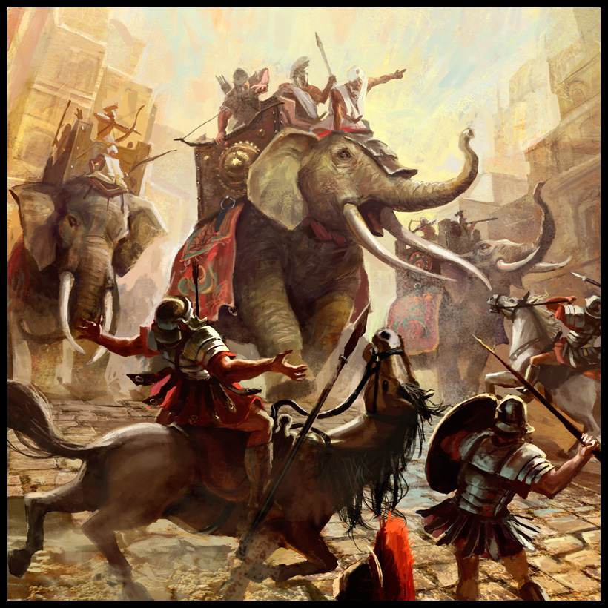
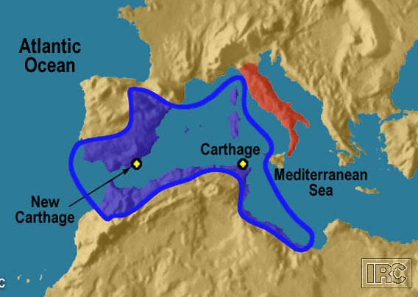
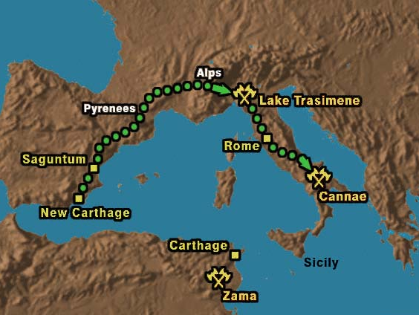
Roman Expansion: Punic Wars
1st Punic War – fight for island of Sicily. Romans-large navy = wins Sicily. Carthage vowed revenge.
2nd Punic War- Hannibal (Carthage ,Africa) Invades Rome through Spain & over Alps (elephants)- Romans Surprised & almost lost. Rome attacks Carthage --Hannibal out of Rome– gains Spain.
3rd Punic War –Destroyed Carthage-Roman Province. Carthaginians -into slavery. Rome captured Macedonia, Greece & Pergamum= dominant Mediterranean power.
Carthaginian Empire
Hannibal’s Route
Notes:
After conquest in Italy Romans face Carthage in Africa.
Phoenicians had discovered carthage 800B.C in Africa. By third cen B>C Carthage was a large trading center from Spain to Sicily.
1st Punic war -Carthaginians were powerful and had control of the Island of Sicily which was close to the Italian Peninsula and made the Romans nervous so they sent in troops to Sicily. Carthaginians had a navy and the Romans did not. Romans realized in order to win war they needed a navy so they created one. When the war came to an end Rome gained Sicily.
2nd war- Hannibal was a Carthaginian General and decided to get revenge on Rome by invading the Italian peninsula. Little did he know this would be his great demise. He decided instead of by sea take his army around the back way into Italy through the alps. The Romans would never expect such a move. He made it through and fought the Roman army head on. The Romans received heavy loses but did regroup. He is left to roam through Italy and eventually the Roman army regroups and starts to take back their land. Eventually the Romans attack Carthage and Hannibal has to return to try and help but his forces are too few. Rome gains Spain from Carthage.
3rd Punic War Carthage becomes part of the Roman empire.

Slide 9
5-1 Section Review
People who expanded from Etruria
Etruscans
Were chosen every year, ran the government, and led the army into battle
Two Consuls
Rome’s first code of laws were the what?
Twelve Tables
Form of government with right to vote for citizens
Republic

Slide 10
5-1 Section Review
The Roman Senate were a select group of what?
Patricians
Carthaginian general
Hannibal
They excelled at military matters, governing other peoples, and law.
Romans
Group of craftsmen, merchants, and small farmers
Plebeians

Slide 11
5-1 Section Review
Great landowners, ruling class
Patricians
Rome defeated, then destroyed, Carthage in what?
Punic Wars

